Slide 1
CS595—Big Data Technologies
Module 08
High Velocity Data Processing
Apache Kafka

Slide 2
High Level View

Slide 3
What is High Velocity Data Processing?
AKA Streaming or Stream Processing
So far we have focused on batch processing of data file
Sitting in HDFS, queried with Hive, transformed with Pig & Spark
Using Sqoop as an ingestion tool… sitting in databases
But how does new data get into Hadoop at the time it is generated?
New log entries from your web servers
New sensor data from you IoT systems
New transactions form oyur PoS systems
Stream processing lets you accept this data from external systems into your Hadoop cluster in real time
And you can even process it in real time on its arrival

Slide 4
Two Aspects of Stream Processing
Accepting data from different sources into Hadoop
Processing the data ASAP when it gets into there

Slide 5
Accepting Data into Hadoop in Real Time Using Kafka
Kafka is a general purpose publish and subscribe messaging system
Kafka servers/nodes accept and store incoming messages from data sources
Data sources are referred to as data publishers
Kafka stores messages into groupings as topics
Message consumers, known as subscribers, register interest with Kafka about one or more topics
When data is stored in a topic it is made available to that topic’s subscribers

Slide 6
Accepting Data into Hadoop in Real Time Using Kafka
Kafka systems may be used by apps executing on Hadoop
But Kafka can also be used generally as a very high reliability and high performance message processing system

Slide 7
Kafka Architecture Initial Perspective
Publishers
(Producers)
App
App
App
Connectors
DB
Messages
Send to Topics
New/Changed
Record
Kafka Cluster
App
Stream
Processors
New/Changed
Record
DB
Messages
Read from Topics
App
App
App
Subscribers
(Consumers)

Slide 8
Detailed View

Slide 9
Apache Kafka
A distributed publish and subscribe messaging system rethought as a distributed commit log
More on “commit log” and “publish subscribe” in a bit
Developed at LinkedIn
Provides a solution to handling the ingestion of high volume and high velocity data into Hadoop clusters

Slide 10
Apache Kafka
Apache Kafka is fast becoming the preferred messaging infrastructure for dealing with contemporary, data-centric workloads such as Internet of Things, gaming and online advertising
The ability to ingest data at a lightening speed makes it an ideal choice for building complex data processing pipelines
Kafka is designed from the ground up to deal with transporting millions of high velocity events generated in rapid succession
It guarantees low latency and “at-least-once”, delivery of messages to consumers
Kafka also supports retention of data for offline consumers
Which means that the data can be processed either in real-time or in offline/batch mode

Slide 11
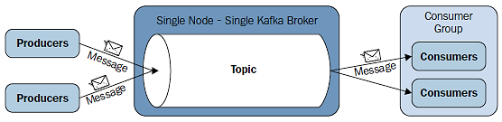
Apache Kafka
A producer publishes messages to a Kafka topic
Topics represent a logical collection of messages
Consumers subscribe to the Kafka topics to get the messages
Each consumer is a process or thread and these are organized into consumer groups

Slide 12
Why Kafka?
Feature | Description
High Throughput | Support for up to millions of messages/s with relatively modest cluster computing hardware
Scalability | Horizontally scalable with no down time
Replication | Messages can be replicated across a cluster which provides load balancing and failure support
Durability | Provides support for persistence of messages even across network, disk and server failures
Integration | Kafka can be used with real time streaming systems like Spark Streaming and Storm

Slide 13
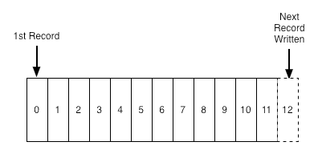
What Is a Log?
A log is perhaps the simplest possible storage abstraction
It is an append-only, totally-ordered sequence of records ordered by time. It looks like this:
Records are appended to the end of the log, and reads proceed left-to-right
Each entry is assigned a unique sequential log entry number
The ordering of records defines a notion of "time"
Since entries to the left are defined to be older then entries to the right
Log entry number can be thought of as the "timestamp" of the entry

Slide 14
What Is a Log?
The ordering of records defines a notion of "time" since entries to the left are defined to be older then entries to the right. The log entry number can be thought of as the "timestamp" of the entry.

Slide 15
Logs in Databases (Commit Logs)
The most crucial structure for database recovery operations
Store all of the changes made to the database as they occur
Only reliable source of information about current state of the database
Used to recover consistent state of a database, upon failure

Slide 16
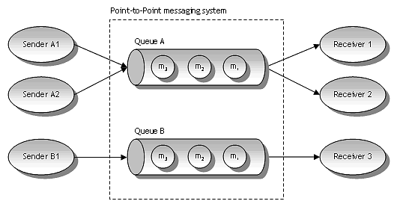
What is a Messaging System?
Responsible for transferring data from one application to another
So the applications can focus on data and not worry about how to share it
Distributed messaging is based on the concept of reliable message queuing

Slide 17
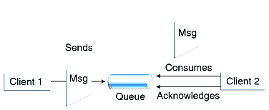
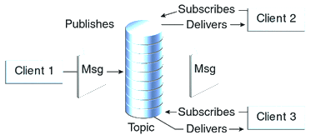
What is a Messaging System?
Two types of messaging patterns are possible in a messaging system
Point to point
Publish-subscribe

Slide 18
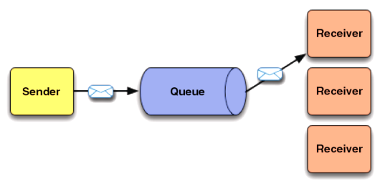
Point to Point Messaging System
In a point-to-point system, messages are persisted in a queue
One or more consumers can consume messages
But each message can be consumed by one consumer only
Once a consumer reads a message it disappears from that queue
The following diagram depicts the structure

Slide 19
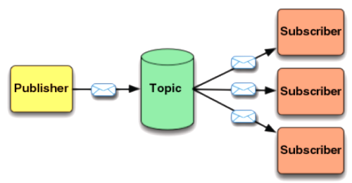
Publish-Subscribe Messaging System
In the publish-subscribe system, messages are persisted in one or more topics (think file folders or feeds)
Unlike point-to-point system, consumers can subscribe to one or more topics and consume all the messages in that topic
Here message producers are called publishers and message consumers are called subscribers
The following diagram depicts the structure

Slide 20
Publish-Subscribe Messaging System
One example of this model is Twitter
A publisher established an account (a topic)
Multiple subscriber then indicate interest in (subscribe) receiving tweets from that account
The publisher then enters (publish) one or more tweets (message)
Each tweet (message) is then made available to every subscriber of that account (topic)

Slide 21
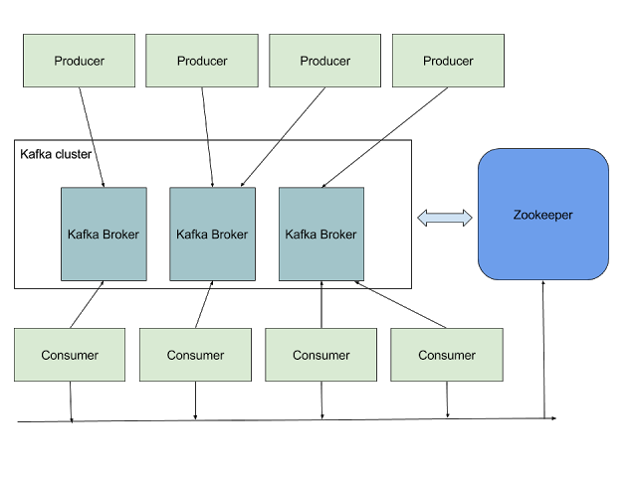
Kafka Architectural Landscape

Slide 22
Messages and Batches
The unit of data within Kafka is called a message
If you are approaching Kafka from a database background, you can think of this as similar to a row or a record
A message is simply an array of bytes, as far as Kafka is concerned, so the data contained within it does not have a specific format or meaning to Kafka
Messages can have an optional bit of metadata which is referred to as a key
The key is also a byte array, and as with the message, has no specific meaning to Kafka
Keys are used when messages are to be written to partitions in a more controlled manner.

Slide 23
Messages and Batches
For efficiency, messages are written into Kafka in batches
A batch is just a collection of messages, all of which are being produced to the same topic and partition
An individual round trip across the network for each message would result in excessive overhead, and collecting messages together into a batch reduces this
This, of course, presents a tradeoff between latency and throughput…
The larger the batches, the more messages that can be handled per unit of time…
But the longer it takes an individual message to propagate
Batches are also typically compressed, which provides for more efficient data transfer and storage at the cost of some processing power

Slide 24
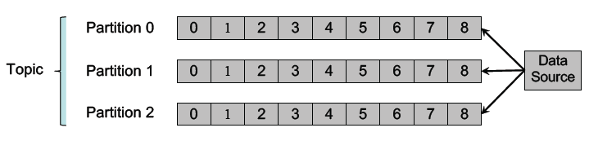
Topics and Logs
Messages are organized into topics, and each topic is split into partitions
Each partition is an immutable, time-sequenced log of messages on disk
Note that time ordering is guaranteed within, but not across, partitions

Slide 25
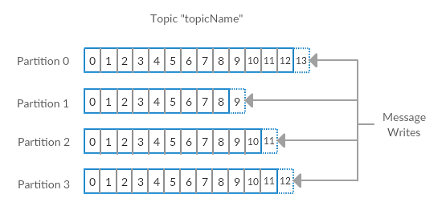
Topics and Logs
Here we show a topic with 4 partitions, with writes being appended to the end of each one
Partitions are also the way Kafka provides redundancy and scalability
Each partition can be hosted on a different server
This means that a single topic can be scaled horizontally across multiple servers…
To provide for performance far beyond the ability of a single server

Slide 26
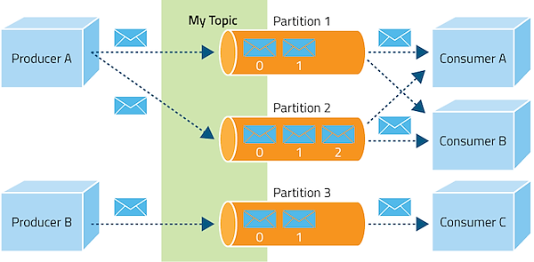
Topics and Logs Architectural Detail
.

Slide 27
Topics and Logs
Each partition is an ordered, immutable sequence of records that is continually appended to—a structured commit log
The records in the partitions are each assigned a sequential id number called the offset which uniquely identifies each record within the partition
The cluster retains all published records, whether or not they have been consumed using a configurable retention period
For example, if the retention policy is set to two days…
Then for the two days after a record is published, it is available for consumption after which it will be dropped to free up space
Kafka's performance is effectively constant with respect to data size so storing data for a long time is not a problem

Slide 28
Topics and Logs
The partitions in the log serve several purposes…
First, they allow the log to scale beyond a size that will fit on a single server
Each individual partition must fit on the server that hosts it
But a topic may have many partitions (distributed across multiple servers)
This allows a topic to handle an arbitrary amount of data
Second partitions act as the unit of parallelism—more on that in a bit

Slide 29
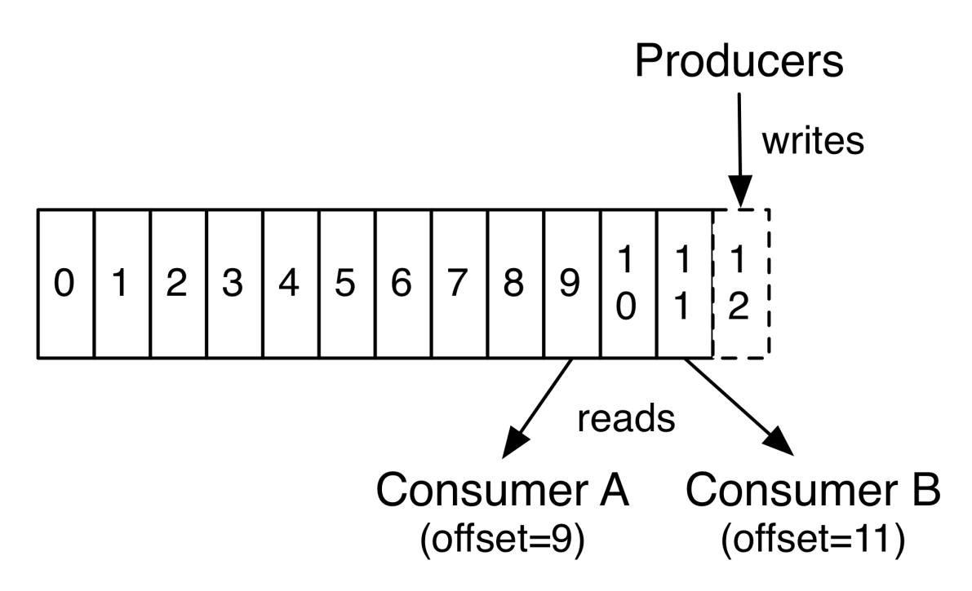
Topics and Logs
The only metadata retained on a per-consumer basis is the offset or position of that consumer in the log
This offset is controlled by the consumer and saved in a special Kafka topic
Normally a consumer will advance its offset linearly to the next as it reads records

Slide 30
Topics and Logs
But, in fact, since the position is controlled by the consumer it can consume records in any order it likes
For example a consumer can reset to an older offset to reprocess data from the past
Or the consumer can skip ahead to the most recent record and start consuming from "now"

Slide 31
Topics and Logs
So Kafka does not need complex logic to provide the consumers with their next message
This means that Kafka consumers are very cheap…
They can come and go without much impact on the cluster or on other consumers

Slide 32
Brokers and Clusters
Each Kafka instance belonging to a cluster is called a broker
The brokers primary responsibilities are…
To receive messages from producers
To assign offsets to these messages
To commit these messages to persistent storage
Each broker can easily handle thousands of partitions and millions of messages per second.
The partitions in a topic may be distributed across multiple brokers
This redundancy ensures high availability of messages

Slide 33
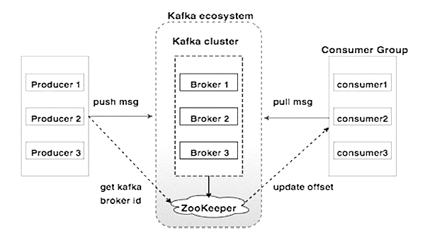
Brokers and Clusters Architectural Detail

Slide 34
Brokers and Clusters
Within a cluster of brokers, one will always function as the cluster controller
This controller is elected automatically from the live broker members of the cluster
The controller is responsible for administrative operations, including assigning partitions to brokers and monitoring for broker failures

Slide 35
Partitions
The partitions of each topic are distributed over servers in the Kafka cluster…
With each server handling data and requests for a share of the partitions
Each partition is replicated across a configurable number of servers for fault tolerance
While sending data, producers don’t mention the partition but consumers are aware of the available partitions
Kafka may use the message key to automatically group similar messages into a partition
This scheme enables Kafka to dynamically scale the messaging infrastructure

Slide 36
Partitions
Each partition has one server which acts as the "leader" and zero or more servers which act as "followers“
The leader handles all read and write requests for the partition while the followers passively replicate the leader
If the leader fails, one of the followers will automatically be promoted become to the new leader
Each server acts as a leader for some of its partitions and a follower for others
This allow I/O load to be well balanced within the cluster

Slide 37
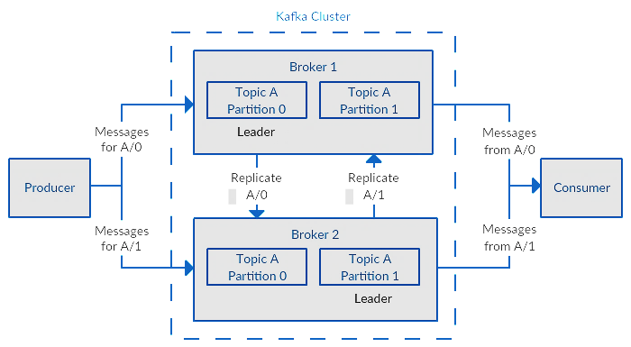
Partitions

Slide 38
Partitions
In replication, each partition of a message has n replicas and can afford n-1 failures to guarantee message delivery
Out of the n replicas, one replica acts as the lead replica for the rest of the replicas
ZooKeeper keeps the information about the lead replica and the current in-sync follower replica
The lead replica maintains the list of all in-sync follower replicas

Slide 39
The Role of ZooKeeper
Kafka uses Apache ZooKeeper as a distributed configuration store
It forms the backbone of Kafka cluster that continuously monitors the health of the brokers
When new brokers get added to the cluster, ZooKeeper will start utilizing it by creating topics and partitions on it
Initial versions of Kafka used ZooKeeper for storing the partition and offset information for each consumer
Starting from Kafka version 0.10, that information has moved to an internal Kafka topic

Slide 40
Producers
Producers publish data to the topics of their choice
The producer is responsible for choosing which record to assign to which partition within the topic
This can be done in a round-robin fashion simply to balance load
Or it can be done according to some partition function (say based on some key in the record)

Slide 41
Consumers
Consumers label themselves with a consumer group name…
And each record published to a topic is delivered to one consumer instance within each subscribing consumer group
If all the consumer instances have the same consumer group, then the records will effectively be load balanced over the consumer instances
If all the consumer instances have different consumer groups, then each record will be broadcast to all the consumer processes

Slide 42
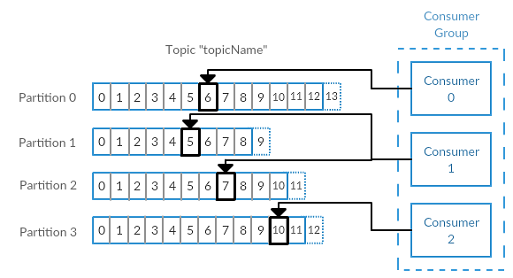
Consumers
Consumers are clients that consume records from a cluster
Consumers work together as part of a consumer group
This is one or more consumers that work together to consume a topic
The group assures each partition is only consumed by one member
Below there are three consumers in a single group consuming a topic
Two of the consumers are working from one partition each, while the third consumer is working from two partitions

Slide 43
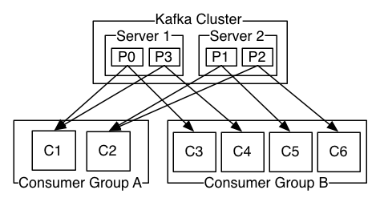
Consumers
Here is an example of a two server Kafka cluster hosting a four partition (P0-P3) topic with two consumer groups
Consumer group A has two consumer instances and group B has four

Slide 44
Consumers
Each group is composed of many consumer instances for scalability and fault tolerance
This is nothing more than an extension of typical publish-subscribe semantics…
But here the subscriber is a cluster of consumers instead of a single process

Slide 45
Consumer Groups
Kafka consumers are typically part of a consumer group
When multiple consumers are subscribed to a topic and belong to the same consumer group…
Then each consumer in the group will receive messages from a different subset of the partitions in the topic

Slide 46
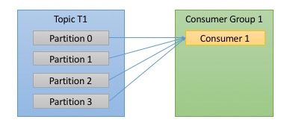
Consumer Groups
Lets take topic t1 with 4 partitions
Now suppose we created a new consumer, c1, which is the only consumer in group g1 and use it to subscribe to topic t1
Consumer c1 will get all messages from all four of t1 partitions

Slide 47
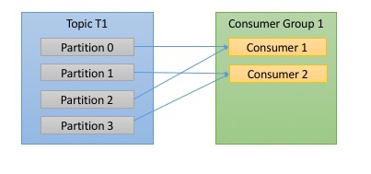
Consumer Groups
If we add another consumer, c2 to group g1, each consumer will only get messages from two partitions
Perhaps messages from partition 0 and 2 go to c1 and messages from partitions 1 and 3 go to consumer c

Slide 48
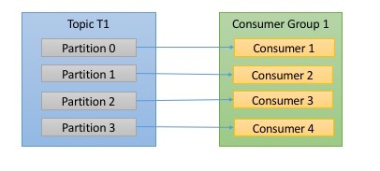
Consumer Groups
If g1 has 4 consumers, then each will read messages from a single partition

Slide 49
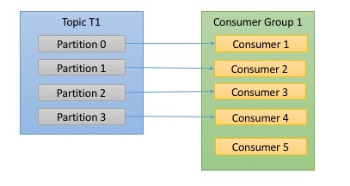
Consumer Groups
If we add more consumers to a single group with a single topic than we have partitions…
Then some of the consumers will be idle and get no messages at all.

Slide 50
Consumer Groups
The main way we scale consumption of data from a Kafka topic is by adding more consumers to a consumer group
It is common for Kafka consumers to do high latency operations such as write to a database or to HDFS, or a time-consuming computation on the data
In these cases, a single consumer can’t possibly keep up with the rate data flows into a topic, and adding more consumers that share the load by having each consumer own just a subset of the partitions and messages is our main method of scaling
This is a good reason to create topics with a large number of partitions - it allows adding more consumers when the load increases
Keep in mind that there is no point in adding more consumers than you have partitions in a topic - some of the consumers will just be idle.

Slide 51
Consumer Groups
It is very common to have multiple applications that need to read data from the same topic
In fact, one of the main design goals in Kafka was to make the data produced to Kafka topics available for many use-cases throughout the organization
In those cases, we want each application to get all of the messages, rather than just a subset
To make sure an application gets all the messages in a topic…
You make sure the application has its own consumer group

Slide 52
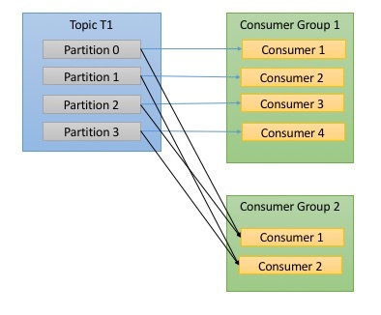
Consumer Groups
If we add a new consumer group 2 it will get messages in topic t1 independently of what group1 is doing

Slide 53
Guarantees
At a high-level Kafka gives the following guarantees:
Messages sent by a producer to a particular topic partition will be appended in the order they are sent
That is, if a record M1 is sent by the same producer as a record M2, and M1 is sent first, then M1 will have a lower offset than M2 and appear earlier in the log
A consumer instance sees records in the order they are stored in the log
For a topic with replication factor N, we will tolerate up to N-1 server failures without losing any records committed to the log

Slide 54
Using Kafka Four Core APIs
The Producer API allows an application to publish a stream of records to one or more Kafka topics.
The Consumer API allows an application to subscribe to one or more topics
And process the stream of records produced to them
The Streams API allows an application to consume input streams from topics and produce output streams to topics
Effectively transforming the input streams to output streams
The Connector API allows building and running producers or consumers that connect topics to existing apps or data systems.
For example, a connector to a relational database might capture every change to a table

Slide 55
Kafka Producer Overview
Here is an example of using a Kafka producer to send records with strings containing sequential numbers as key/value pairs
From an implementation perspective the produce has…
A pool of buffer space that holds records (messages) that haven't yet been transmitted to the server
A background I/O thread responsible for turning these records into requests and transmitting them to the Kafka cluster
The example shows the four principle phases of a Kafka producer’s lifecycle
Setting the operating configuration of the producer
Creating the producer
Sending one or more messages to brokers (servers)
Closing the producer to release any resources

Slide 56
Kafka Producer Phase 1—Setting up the operational configuration
The following code snippet shows how to set up the operating configuration (phase 1) of a new Producer
Properties props = new Properties();
props.put("bootstrap.servers", ” sandbox.hortonworks.com:6667");
props.put("acks", "all");
props.put("retries", 0);
props.put("batch.size", 16384);
props.put("linger.ms", 1);
props.put("buffer.memory", 33554432);
props.put("key.serializer", "org.apache.kafka.common.serialization.StringSerializer");
props.put("value.serializer", "org.apache.kafka.common.serialization.StringSerializer");

Slide 57
Kafka Producer Phase 1—Setting up the operational configuration
Name | Description
bootstrap.servers | A list of host/port pairs to use for establishing the initial connection to the Kafka cluster
key.serializer | The producer will use this class to serialize the message key object to a byte array.
value.serializer | The producer will use this class to serialize the message value object to a byte array

Slide 58
Kafka Producer Phase 1—Setting up the operational configuration
Name | Description
acks | The number of acknowledgments the producer requires the leader to have received before considering a request complete. This controls the durability of records that are sent. The following settings are allowed acks=0 If set to zero then the producer will not wait for any acknowledgment from the server at all.. acks=1 This will mean the leader will write the record to its local log but will respond without awaiting full acknowledgement rom all followers. acks=all This means the leader will wait for the full set of in-sync replicas to acknowledge the record. This guarantees that the record will not be lost as long as at least one in-sync replica remains alive. This is the strongest available guarantee.

Slide 59
Kafka Producer Phase 1—Setting up the operational configuration
Name | Description
batch.size | The default batch size in bytes. The producer will attempt to batch records together into fewer requests whenever multiple records are being sent to the same partition.
linger.ms | Adds a small amount of artificial delay. Rather than immediately sending out a record the producer will wait for up to the given delay to allow other records to be sent so that the sends can be batched together

Slide 60
Kafka Producer Phase 2—Creating the producer
The following code snippet shows how to create a new Producer with the previously specified configuration
Producer<String, String> producer = new KafkaProducer<>(props);
Note, here the producer is expected to send messages with keys and values of type String
This declaration corresponds to the types of serializers indicated in the configuration

Slide 61
Kafka Producer Phase 3—Sending one or more messages to brokers
We start by creating a ProducerRecord, which must include the topic we want to send the record to and a value we are sending
Optionally, we can also specify a key and a partition
Once we send the ProducerRecord, the first thing the producer will do is serialize the key and value objects to ByteArrays, so they can be sent over the network
msg= new ProducerRecord<String, String>(
"my-topic", ← topic to send to
Integer.toString(i), ← key, a string
Integer.toString(i))); ← value, a string

Slide 62
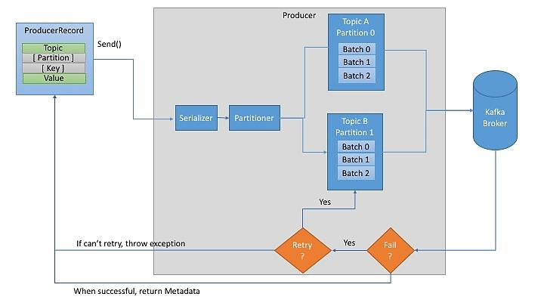
Kafka Producer Phase 3—Sending one or more messages to brokers

Slide 63
Kafka Producer Phase 3—Sending one or more messages to brokers
Next, the data is sent to a partitioner
If we specified a partition in the ProducerRecord, the partitioner doesn’t do anything and simply returns the partition we specified
If we didn’t, the partitioner will choose a partition for us, usually based on the ProducerRecord key

Slide 64
Kafka Producer Phase 3—Sending one or more messages to brokers
Once a partition is selected, the producer knows which topic and partition the record will go to
It then adds the record to a batch of records that will also be sent to the same topic and partition
A separate thread is responsible for sending those batches of records to the appropriate Kafka brokers.

Slide 65
Kafka Producer Phase 3—Sending one or more messages to brokers
When the broker receives the messages, it sends back a response
If the messages were successfully written to Kafka…
It will return a RecordMetadata object with the topic, partition and the offset of the record in the partition
If the broker failed to write the messages…
It will return an error
When the producer receives an error…
It may retry sending the message few more times before giving up and returning an error

Slide 66
Kafka Producer Phase 3—Sending one or more messages to brokers
for(int i = 0; i < 100; i++)
producer.send(
new ProducerRecord<String, String>(
"my-topic",
Integer.toString(i),
Integer.toString(i)));
In this case the send() method is asynchronous with no callback
When called it adds the record to a buffer of pending record sends and immediately returns
This allows the producer to batch together individual records for efficiency

Slide 67
Kafka Producer Phase 3—Sending one or more messages to brokers
There are three primary methods of sending messages:
Synchronous Send
We send a message and then wait and see if the send was successful or not
Asynchronous Send wo/ Callback (“Fire and Forget”)
We send a message to the server and don’t really care if it arrived successfully or not (as our previous example)
If the send fails, the producer will retry, up to the configured “retries” count, but will not be notified of a retry or other failure
Asynchronous Send w/ Callback
We call the send() method with a callback function, which gets triggered when receive a response (ok or error) from the Kafka broker

Slide 68
Kafka Producer Phase 3—Sending one or more messages to brokers
Here we send message synchronously is as follows:
ProducerRecord<String, String> record =
new ProducerRecord<>("CustomerCountry", "Precision Products", "France");
try {
producer.send(record).get();
} catch (Exception e) {
e.printStackTrace();
}
We are using Future.get() to wait until the reply from Kafka arrives back

Slide 69
Kafka Producer Phase 3—Sending one or more messages to brokers
In order to send messages asynchronously and still handle error scenarios, send() supports adding a callback
private class DemoProducerCallback implements Callback {
@Override
public void onCompletion(RecordMetadata recordMetadata, Exception e) {
if (e != null) {
e.printStackTrace();
}
}
}
ProducerRecord<String, String> record =
new ProducerRecord<>("CustomerCountry", "Biomedical Materials", "USA");
producer.send(record, new DemoProducerCallback());

Slide 70
Kafka Producer Phase 3—Sending one or more messages to brokers
Batching is one of the big drivers of efficiency in Kafka
And to enable batching the Kafka producer will attempt to accumulate data in memory and to send larger batches in a single request
The batching can be configured to accumulate no more than a fixed number of messages and to wait no longer than some fixed latency bound (say 64k or 10 ms.)
This allows the accumulation of more bytes to send, and few larger I/O operations on the servers
Buffering is configurable and gives a mechanism to trade off a small amount of added latency for better throughput

Slide 71
Kafka Producer Phase 4—Closing the producer to release any resources
The producer has a pool of buffer space to holds records and a background thread for transmitting records
Failure to close the producer after use will leak these resources
producer.close();

Slide 72
Kafka Consumer Overview
The example shows the four principle phases of a Kafka consumer’s lifecycle
Setting the operating configuration of the consumer
Creating the consumer
Subscribing to one or more topics
Polling for messages from subscribed to topics
Closing the consumer to release any resources

Slide 73
Kafka Consumer Phase 1—Setting the operating configuration of the consumer
We need to supply these mandatory properties…
bootstrap.servers, key.deserializer and value.deserializer
Often, as below, we provide the following property…
group.id
We will use Strings as both key and value, so we use the built-in StringDeserializer and we create KafkaConsumer with String types
Properties props = new Properties();
props.put("bootstrap.servers", "broker1:9092,broker2:9092");
props.put("group.id", "CountryCounter");
props.put("key.deserializer", "org.apache.kafka.common.serialization.StringDeserializer");
props.put("value.deserializer", "org.apache.kafka.common.serialization.StringDeserializer");
KafkaConsumer<String, String> consumer = new KafkaConsumer<>(props);

Slide 74
Kafka Consumer Phase 1—Setting the operating configuration of the consumer
We need to supply these mandatory properties…
bootstrap.servers, key.deserializer and value.deserializer
Often, as below, we provide the following property…
group.id
We will use Strings as both key and value, so we use the built-in StringDeserializer and we create KafkaConsumer with String types
Properties props = new Properties();
props.put("bootstrap.servers", "broker1:9092,broker2:9092");
props.put("group.id", "CountryCounter");
props.put("key.deserializer", "org.apache.kafka.common.serialization.StringDeserializer");
props.put("value.deserializer", "org.apache.kafka.common.serialization.StringDeserializer");
KafkaConsumer<String, String> consumer = new KafkaConsumer<>(props);

Slide 75
Kafka Consumer Phase 1—Setting the operating configuration of the consumer grouup.id configuration parameter
Kafka uses the concept of consumer groups to allow a pool of processes to divide the work of consuming and processing records
All consumer instances sharing the same group.id will be part of the same consumer group
Each consumer in a group can set the list of topics it wants to subscribe to through one of the subscribe APIs
Kafka will deliver each message in the subscribed topics to one process in each consumer group
This is achieved by balancing topic partitions between members in the consumer group…
So that each partition is assigned to exactly one consumer in the group
So if there is a topic with four partitions, and a consumer group with two processes, each process would consume from two partitions

Slide 76
Kafka Consumer Phase 2—Creating the consumer
The following code snippet shows how to create a new Consumer with the previously specified configuration
Consumer<String, String> consumer = new KafkaConsumer<>(props);
Note, here the consumer is expected to receive messages with keys and values of type String
This declaration corresponds to the serializer types indicated in the configuration

Slide 77
Kafka Consumer Phase 3—Subscribing to one or more topics
Once we created a consumer, the next step is to subscribe to one or more topics
The subscribe() method takes a list of topics as a parameter, so its pretty simple to use
consumer.subscribe(Collections.singletonList("customerCountries"));

Slide 78
Kafka Consumer Phase 3—Subscribing to one or more topics
It is also possible to call subscribe with a regular expression
The expression can match multiple topic names
If someone creates a new matching topic the consumer will start consuming from that topic too
This is useful for applications that need to consume from multiple related topics…
To subscribe to all test topics, we can call…
consumer.subscribe("test.*");

Slide 79
Kafka Consumer Phase 4—Polling for messages from subscribe to topics
At the heart of the consumer API is a simple loop for polling the server for more data
while (true) {
ConsumerRecords<String, String> records = consumer.poll(100);
for (ConsumerRecord<String, String> record : records)
{
int updatedCount = 1;
if (custCountryMap.countainsKey(record.value())) {
updatedCount = custCountryMap.get(record.value()) + 1;
}
custCountryMap.put(record.value(), updatedCount)
JSONObject json = new JSONObject(custCountryMap);
System.out.println(json.toString(4))
}
}
}

Slide 80
Kafka Consumer Phase 4—Polling for messages from subscribe to topics
Kafka maintains a numerical offset for each record in a partition
This offset acts as a unique identifier of a record within that partition…
And also denotes the position of the consumer in the partition
A consumer which is at position 5 has consumed records with offsets 0 through 4 and will next receive the record with offset 5
The poll() fetches data topics to which the consumer has subscribed
On each poll(), the consumer will use the last consumed offset as the starting offset and fetch sequentially

Slide 81
Kafka Consumer Phase 4—Polling for messages from subscribe to topics
The poll() fetches data for subscribed to topics
On each poll, the consumer will try to use the last consumed offset as the starting offset and fetch sequentially
The last consumed offset can be manually set through seek(TopicPartition, long)
Otherwise the offset is automatically set as the last committed offset for the subscribed list of partitions

Slide 82
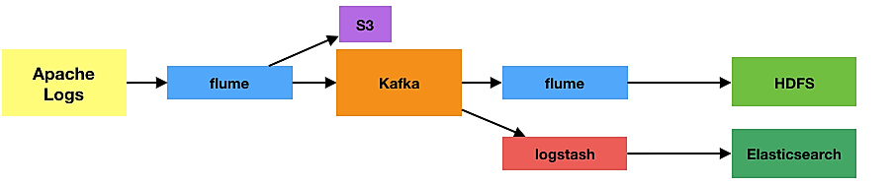
Kafka As Part of a Message Processing Pipeline

